Slide 1
TECHNICAL ZONE TRAINING

Slide 2
Functional roles
To produce a clearly defined policy whereby no one is in doubt of the roles for sideline personnel and technical zone management:
Managing the TZ
Ensuring teams have correct number of personnel in place, ensuring teams move into and away from the TZ quickly between matches, answering any queries from other TZ personnel.
Managing substitutions
Looking after each team and ensuring all substitutions are managed in a timely manner and using the correct protocol.

Slide 3
Co-ordinating substitutions
Receiving the substitution cards, recording substitutions, double checking them and filing them with tournament office.
Scoring – Keep score of Tries, Goal Kicks, Penalty Kicks and Drop Kicks. (Players name and time)
Keeping manual score of the match, recording scorers.
Time keeping
Keeping manual time of the match, temporary suspensions, blood bin, extra time, etc.

Slide 4
Replacements and substitutions
Establishes positive relationships with the relevant team manager or the person administering the replacements and substitutions for a team
Receives the replacement/substitution cards from the team manager and checks that it has been fully completed and confirms whether the change is a replacement for injury or a tactical substitution
Involves the match doctor where one is present if matters cannot be resolved
Communicates with the match referee that a player is being replaced or substituted and receives acknowledgement from the referee that this may occur
Ensures that players exiting or entering the field of play do so from the halfway line

Slide 5
Replacements and substitutions
In Fifteens, utilises the signal boards for the benefit of spectators
Ensures that a player entering the field of play does not do so until a substituted player starts moving and is clearly identified
Maintains records of replacements and substitutions to ensure compliance with Law
Reports any actions contrary to Law or the TZ protocol to the Match Referee
Ensures that replacements/substitutes warm-up in the correct in-goal area and do so without balls or equipment (save when there are additional warm-up areas when balls and equipment may be used).
After the match, reports any acts of misconduct to the referee/match commissioner/match director as appropriate

Slide 6
Management of temporary suspensions
Ensures that the suspended player sits in the position assigned
Communicates with the match referee that a suspended player is returning to the field of play and waits for the signal from the referee
Maintains a record of the temporary suspensions.
Scoring
Keeps manual score of the match in a time line format
Keeps record of actual scorers (team, number)

Slide 7
Management of personnel in the TZ
Establishes positive relationships with the permitted TZ personnel
Ensures that the water carriers remain in the TZ save for when they are permitted on the field of play
Ensures that medical personnel roam on the permitted sides of the pitch in accordance with the protocol
Ensures that water is provided to players in accordance with the TZ protocol
Ensures personnel not permitted in the TZ do not enter
Manages any breaches of the protocol. If breaches continue reports the matters to the match referee
After the match, reports any acts of misconduct to the referee/match commissioner/match director as appropriate

Slide 8
Management of personnel in the TZ (NB !!!!!)
1) No coaches behind the posts
2) All the spectators on the pavilions and not just behind a barricade stretched 5m from side-line, if there are pavilions.
3) During injury no coach on the field.
4) 1 x Physio on each side of field is allowed.
5) Coaches without ‘BokSmart’ should be on pavilion. Not part of team at all. Not even half time.
6) Table should have coaches' ‘BokSmart’ detail if the ref asks for it.

Slide 9
Management of personnel in the TZ (NB !!!!!)
1) No coaches behind the Goal post
2) All the spectators on the pavilions and not behind a barricade 5m from the sidelines when there are pavilions.
3) During an injury no coach on the field.
4) 1 x Physio on each side of field is allowed.
5) Coaches without boksmart must be on the pavilion. Not part of the team . Not even half time.
6) The Table should have the boksmart numbers/copies there off when ref asks for it.

Slide 10
Roles and responsibilities
Sideline Manager
Oversees the management of the sideline area, technical zones, the playing enclosure and all personnel within the sideline area. NB
Technical Zone Manager
Manages information from the Substitution Controllers to the Match Referee and is the point of contact for the Substitution Controllers.
Provide the referee with the infringement, player's detail, time of infringement, and team of all red and yellow cards after the match.

Slide 11
Practical application reminders for TZ
Even with the TZ protocol relatively straightforward and, given that there is only one Law (Law 3 – NUMBER OF PLAYERS – THE TEAM),we are concerned with when it comes to substitutions and replacements, out of the 22 Laws in the Laws of the Game, given scenarios and extended pressure from the teams and the crowd can make it a tough job for all involved.
Therefore, the following practical application reminders (please always refer to the original test of the Laws of the Game) should serve to ensure compliance in the most common situations:
Replacements - replaces an injured player.
Substitutions - substitutes a player for tactical reasons

Slide 12
Exception 1: a substituted player may replace a player with an open or bleeding wound
Exception 2: a substituted player may replace a front row player unless the referee has ordered uncontested scrums
In Sevens, a substituted player may only replace a player with a bleeding or open wound and the Law 3 front row exceptions don’t apply.
In U19, if a team nominates 22 players, it must have at least six players who can play in the front row (loosehead prop, hooker and tighthead prop); if a team nominates more than 22 players there must also be three players who can play in lock position.
The onus to define a suitably trained and experienced player available for the front row is with the team management of this player.

Slide 13
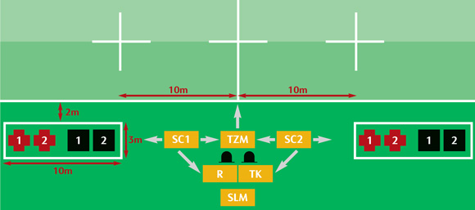
Fifteens Technical Zones
Maximum of four persons allowed in the TZ
Please note: Maximum of x 2 water carriers per TZ in Fifteens

Slide 14
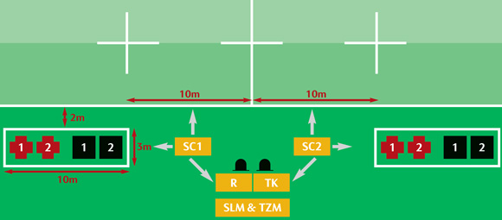
Alternative Fifteens TZ set-up
Please note: Maximum of x 2 water carriers per TZ in Fifteens

Slide 15
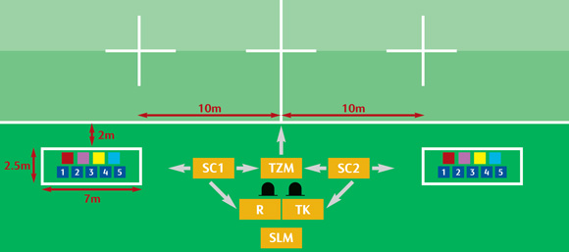
Sevens Technical Zones
Maximum of nine persons allowed in the TZ

Slide 16
Medic
Water carrier
Substitute
Substitution Controller
Technical Zone Manager
Recorder
Time Keeper
Side Line
Medic / Coach
Team Manager
Coach
Physio / Trainer / Medic
Temporary Suspension chair

Slide 17
Each Team is allowed to have the following personnel in the Technical Zone during their Matches: Coach, Team Manager, Physiotherapist and five reserve Players. One additional person who is either a medical or a coaching member of the Team and whose responsibility has previously been notified to the Tournament Director as per Section 4.2 of this Terms of Participation, (and listed on Form C in Section 15) will be permitted in the Technical Zone.
A maximum of three non-playing personnel are allowed to enter the field of play for the purposes of water carrying (which is only permitted when play is stopped for an injury or when a try has been scored). The Manager and Coach are not permitted to act as water carriers at any time. The water carriers must wear the Technical Zone bibs provided by the tournament organiser at all times.
Except as specified in (ii) or as otherwise allowed under the Laws and regulations of the Game, all non-playing personnel must remain inside the Technical Zone, which will be clearly marked.
Provide the referee with the infringement, player's detail, time of infringement, and team of all red and yellow cards after the match.

