Slide 1

















SUSPECTED CATASTROPHIC INJURY/EVENT RESPONSE EMERGENCY ACTION PLAN
GPS Coordinates: 33°56’33.4’’ S; 18°57’22.4’’ E
EVENT/INJURY HAPPENS
(Nearest Player/Official/Medic to stay with the player)
Summon nearest Coach/Referee/Medic to assist
Summon dedicated First Aid Team/Paramedic or Medical Support Staff
Call Medical Doctor/Nurse on duty / standby
Assess information/situation, determine severity and RESPOND ACCORDINGLY as per below
Priority GREEN
Minor
(BASIC FIRST AID)
Priority ORANGE
Moderate → Severe
(REQUIRES SPECIFIC MEDICAL ATTENTION – POSSIBLE REFERRAL/SPECIAL INVESTIGATIONS)
Priority RED
Catastrophic / Fatal
(REQUIRES EMERGENCY INTERVENTION)
Medical Field‐side support
(First Aiders/ Paramedics)
Escort to Medical Station/Room for further Assessment
Manage on‐field. Stop game/practice and call for Paramedical assistance
Provide Basic First Aid
Contact Parents/Family and advise on recommended treatment plan (Hospital casualty/additional Medical Investigations)
Summon Ambulance or nearest
Emergency Service Provider. Where applicable access the
BokSmart Spineline
If required, player removed, and escalate to Medical Station
Where applicable, contact the BokSmart SICM, Mrs. Gail Baerecke, leave a message and log the incident
IMPORTANT CONTACTS:
Ambulance Services:
ER24:
084124
Stellenbosch Ambulance Service
10177
Metro:
021 9370500
Spinal Unit:
Tygerberg Hospital 021 9384911
Private Hospital:
MediClinic Stellenbosch:
021 8612000
Government Hospital:
Stellenbosch Provincial Hospital:
021 8086100
Main Gate Security: Wayne Pearce: 0794476174 Grounds Manager:
Wayne Pearce: 0794476174
BokSmart Spineline
operated by ER24:
0800678678
SICM:
Mrs. Gail Baerecke: 0728903538
Doctor on Duty:
Dr Phathokuhle Cele: 0845568723
Nurse on Duty:
Sister Hermien Kotze: 0845551234
IF required, summon Ambulance or nearest Emergency Service Provider.
Where applicable access the
BokSmart Spineline
Inform Main Gate Security to remain open for Medical Support / Ambulance
Inform Main Gate Security to remain open for Medical Support / Ambulance
Inform Headmaster/Principal Club secretary/Chairperson
Inform Headmaster/Principal Club secretary/Chairperson
Contact player’s parents/next of kin and follow Hospital admission protocols
Debriefing of all role players 24
hours post the event
Submission of completed Serious
Injury Report form to SICM within 48 hours of the incident

Slide 2
Emergency Action Plan Logistics Framework for a Potential Catastrophic Injury:
An emergency action plan must be in place prior to a game commencing or practises taking place. This plan must be accessible, affordable, reproducible and current. This means that all personnel, equipment, emergency transport and referral partners are available at all games throughout the season and where applicable are on standby during practices. The emergency action plan should be amended prior to every fixture. Changes in personnel and their contact details should be clearly marked and their availability confirmed prior to commencement of the fixture. Where rosters of personnel are in place, ensure all relevant personnel are contacted and their availability is confirmed prior to the match or practise.
The following algorithm may be used to manage any potential catastrophic injury. This algorithm may vary from venue to venue depending on the support and facilities available in the immediate area.
However, each Emergency action plan should detail the following logistics:
1.
2.
3.
4.
5.
6.
Layout of the facility and access to the facility Equipment available
Internal support personnel External support personnel Communication required
Follow up required post catastrophic injury
A document should be available that is easily accessible to all emergency personnel and team management involved on match day, or coaches at a practise, and should contain the following:
Layout of the facility and access to the facility:
This should include the Directions to the match or practise venue – GPS coordinates if known would be beneficial to the emergency personnel – including details regarding access and access control procedures. Facility layout including access to field and emergency vehicles should also include the position of keys and other security measures that may hinder quick access of emergency personnel.
Layout specifications | Confirmed and on file (Y/N or N/A)
GPS Coordinates | 33°56'33.4"S, 18°51'22.4"E
1 | Page

Slide 3
Written directions from a known landmark | Landmark = BP Dorp Street (73 Dorp Street, Stellenbosch,7600). Head east on Dorp Street toward Herte Road, ~350m Turn right onto Piet Retief Street Go through 1 roundabout ~450 m Turn right onto Skool Street ~160 m Turn right onto Koch Road ~120 m into Koch Road it turns right and becomes Suidwal Road. Do NOT turn right. Before Koch road turns right into Suidwal Road, there is an exit turning left into the Sports Grounds. Take this You will pass through a security access gate and then the Indoor Hall will be in front of you with the parking lot. This is where we are…
Map with directions highlighted | See Map Below
Facility layout with directions to access the field | Not applicable, as players are in the Indoor training facility, which is directly accessible from the parking lot. Map Below will suffice. Also provided below is the Indoor Hall schematic and Room allocations
Control procedures for accessing the venue and field | None, except for the Security access at the Gate entering into the facility. If any issues… Contact person: Wayne Pearce, Mobile Number: 0794476174
Position of keys to venue and access gates | Keys to open the gate if locked are with, Stephan Jordaan, he has the keys to the access gates and the facilities and is on site. His Office is at the back end of the Indoor Hall, Room 512 Contact number: 0795547832
Additional security measures | Security access at the Gate entering into the facility. If any issues… Contact person: Wayne Pearce, Mobile Number: 0794476174
2 | Page

Slide 4
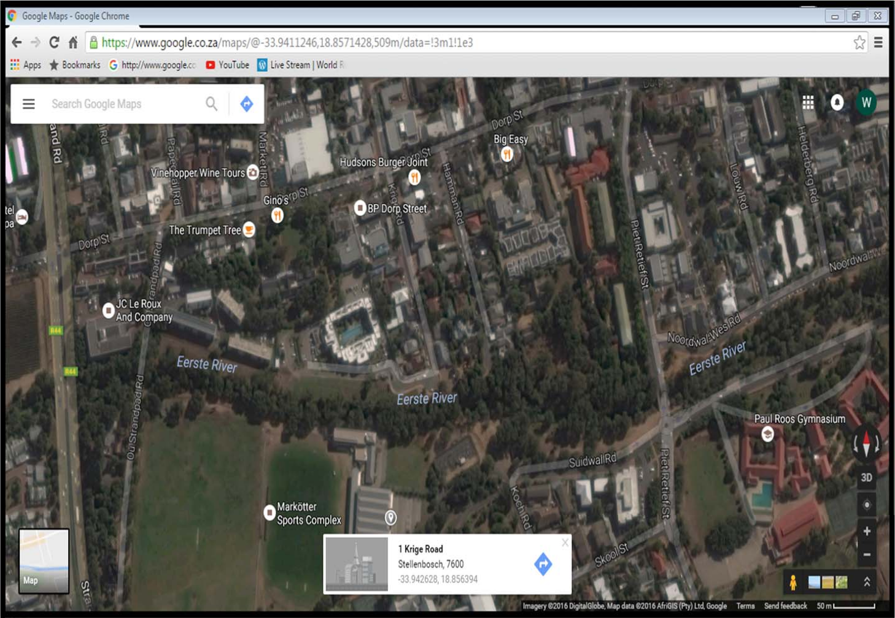
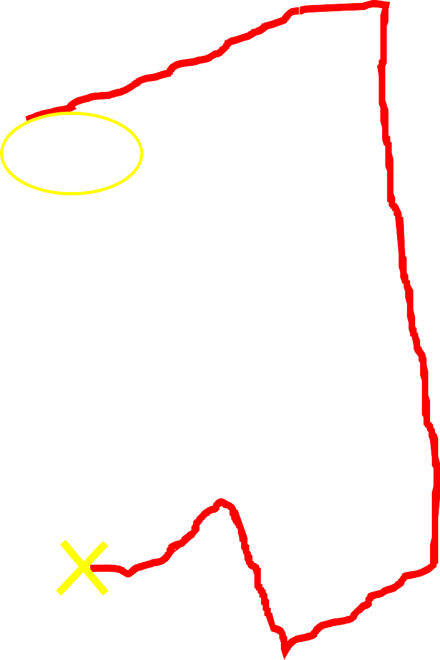
3 | Page

Slide 5
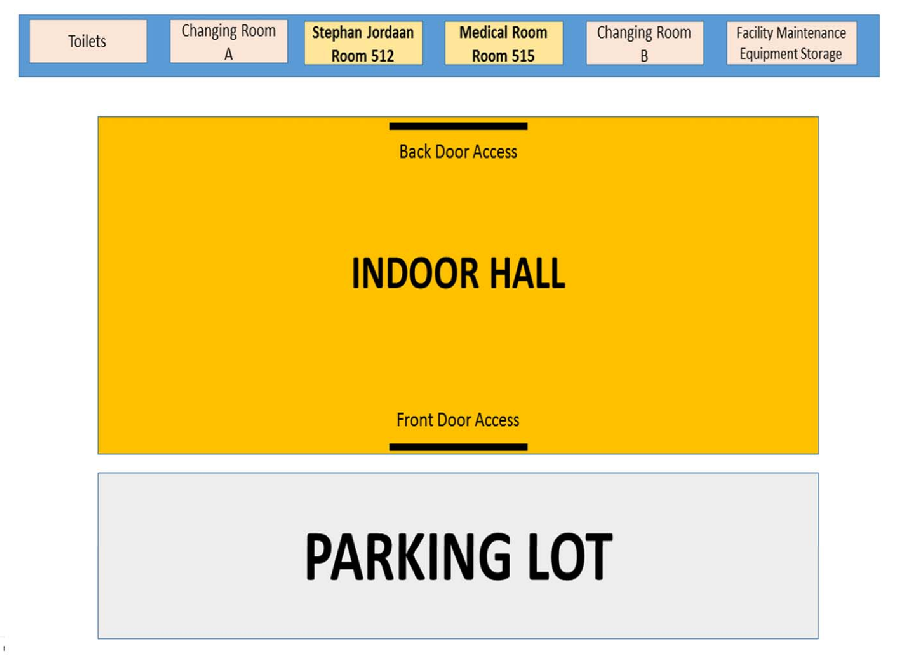
4 | Page

Slide 6
2. Equipment available:
A detailed list should be readily available and visible, detailing all equipment and emergency medication available. Its whereabouts should also be clearly defined.
Equipment | Green | Gold and Gold+ | Whereabouts
Spinal Board and harness | ✓ | ✓ | Room 515 (Medical Room) behind the Indoor hall
Cervical collars and head blocks | ✓ | ✓ | Room 515 (Medical Room) behind the Indoor hall
BLS equipment |  | ✓ | N/A
BokSmart Concussion Guide | ✓ | ✓ | With Coach at Indoor Hall, additional copies in Room 515
SCAT tool | ✓* | ✓ | Room 515 (Medical Room) behind the Indoor hall
First Aid bag | ✓* | ✓ | Room 515 (Medical Room) behind the Indoor hall
ALS Equipment |  | ✓ | N/A
Golf cart |  | ✓ | N/A
* = where indicated, in certain underprivileged or disadvantaged communities, this cannot be seen as a requirement
3. Internal support personnel:
Host club/school/union personnel should have clearly defined roles and responsibilities delineated in the emergency action plan.
School/Club/Union personnel | Confirmed Y/N/NA | Name & Contact number
School Headmaster/Principal | Y | Henry Moll Mobile Number: 0835546789
School Master in Charge of Sport | Y | Stephan Jordaan Mobile Number: 0795547832
Grounds caretaker/Facilities Manager | Y | Wayne Pearce Mobile Number: 0794476174
Club Chairperson | N/A | N/A
Club Secretary | N/A | N/A
Match Secretary | N/A | N/A
Tournament Manager | N/A | N/A
5 | Page

Slide 7
Club/School/Union employed Doctor, Nurse or other Medical support staff | Y | Sister Hermien Kotze (Mobile number: 0845551234) Andrew Court First Aid Level 2, Expiry date: 31 December 2018 (Mobile number: 0762235417)
Medical Doctor on standby for Club/School/Union during practices | Y | Dr Phathokuhle Cele (Mobile number: 0845568723)
4. External support personnel:
The medical personnel required at a rugby game or practise will vary depending on the level of competition. However, the higher the level of training of medical support personnel together with more personnel being available on match day is desirable.
Medical Personnel | Green | Gold | Gold+ | Confirmed Y/N | Name & Contact number
Match Doctor |  |  | ✓ | N/A | N/A
Venue Doctor |  | ✓ | ✓ | N/A | N/A
Specialist services on site |  |  | ✓ | N/A | N/A
Specialist services on standby |  | ✓ | ✓ | N/A | N/A
Nursing sister |  |  | ✓ | N/A | N/A
Medical liaison |  |  | ✓ | N/A | N/A
ALS paramedics |  |  | ✓ | N/A | N/A
ILS paramedics |  | ✓ | ✓ | N/A | N/A
BAA |  | ✓ | ✓ | N/A | N/A
Trained First Aider | ✓ |  |  | N/A | N/A
Ambulance and staff on site |  | ✓ | ✓ | N/A | N/A
Ambulance and staff on standby | ✓ |  |  | Y | ER24 084124 BokSmart Spineline 0800678678
Air staff (on standby) |  | ✓ | ✓ | N/A | N/A
6 | Page

Slide 8
5. Communication required:
Clear communication is the key to effective management of an injured player. Communication w.r.t. the role of each member of the medical team as well as communication between the internal; external and emergency unit / BokSmart Spineline personnel is imperative to ensure not only the optimal care of the player but also to ensure the players management and family are fully informed as to his situation.
LOCAL HOSPITALS/ EMS PROVIDERS | Name | Physical Address | Telephone Number | Distance from Venue
Nearest Accessible | MediClinic Stellenbosch | Address: Saffraan Ave & | Phone: | 1.5 km
Private Hospitals |  | Rokewood Rd, Stellenbosch, | 021
 |  | 7613 | 8612000
Nearest Accessible | Stellenbosch Provincial | Address: Merriman Ave, | Phone: | 3.3 km
Government Hospitals | Hospital | Stellenbosch, 7600 | 021
 |  |  | 8086100
Nearest Spinal Unit | Tygerberg Hospital | Address: Francie Van Zijl Dr, | Phone: | 39 km
Accessible |  | Tygerberg Hospital, Cape | 021
 |  | Town, 7505 | 9384911
Local Private Emergency Service Providers | ER24 | N/A | 084 124 | N/A
Local Government | Stellenbosch Ambulance | N/A | Phone: | N/A
Emergency Service | Service |  | 10177
Providers
 | Metro |  | 021
 |  |  | 9370500
BokSmart Spineline | ER24 (BokSmart Spineline) | N/A | Phone: 0800678678 | N/A
SICM or Serious Injury Case Manager | Mrs. Gail Baerecke | N/A | Phone: 0728903538 | N/A
6. Follow up required post catastrophic injury:
A designated person, normally the Medical Doctor for “Gold” and “Gold+“, or the team coach or manager for “Green” categories, should be nominated to ensure all parties are kept informed as to the condition of the injured player until that time he is returned to the safekeeping of his nearest kin or designated team management member, whichever may be applicable at the time.
For more advice on this matter consult your Safety in the Playing Environment and Tournament Medical and Safety Minimum Standards documents for the additional safety measures and protocols that are compulsory for these levels of matches and tournaments.
These are available on the BokSmart Website www.BokSmart.com or linked Page: http://boksmart.sarugby.co.za/content/playing‐environment‐safety.
The minimum requirements with regards to Field Safety standards are also available on the BokSmart website at the same link. Where the Safety at Sports and Recreational Events Act of 2010 applies, this also needs to be addressed according to Law
7 | Page

Slide 9
CHECKLIST:
Environmental conditions | Green | Gold | Gold+ | Confirmed /
Whirling Hygrometer/ WBGT* | ✓ | ✓ | ✓ | 
Lightning warning system* | ✓ | ✓ | ✓ | 
Telephone access | ✓ | ✓ | ✓ | ✓
Medical Personnel | Green | Gold | Gold+ | Confirmed /
Match Doctor |  |  | ✓ | 
Venue Doctor |  | ✓ | ✓ | 
Specialist services on site |  |  | ✓ | 
Specialist services on standby |  | ✓ | ✓ | ✓
Nursing sister |  |  | ✓ | ✓
Medical liaison |  |  | ✓ | 
ALS paramedics |  |  | ✓ | 
ILS paramedics |  | ✓ | ✓ | 
BAA |  | ✓ | ✓ | 
Trained First aider | ✓ |  |  | ✓
Ambulance and staff on site |  | ✓ | ✓ | 
Ambulance and staff on standby | ✓ |  |  | ✓
Air staff (on standby) |  | ✓ | ✓ | 
Equipment | Green | Gold | Gold+ | Confirmed /
Spinal Board and harness | ✓ | ✓ | ✓ | ✓
Cervical collars and head blocks | ✓ | ✓ | ✓ | ✓
BLS equipment |  | ✓ | ✓ | 
BokSmart Concussion Guide | ✓ | ✓ | ✓ | ✓
SCAT tool | ✓* | ✓ | ✓ | ✓
First Aid bag | ✓* | ✓ | ✓ | ✓
ALS Equipment |  | ✓ | ✓ | 
Golf cart |  | ✓ | ✓ | 
Medical Room | Green | Gold | Gold+ | Confirmed /
Medical tent/station | ✓ |  |  | 
Emergency treatment room |  | ✓ | ✓ | 
Advanced care | Green | Gold | Gold+ | Confirmed /
ALS equipped ambulance on site |  |  | ✓ | 
BLS equipped ambulance on site |  | ✓ |  | 
Access to Emergency medical services | ✓ |  |  | ✓
Trauma unit (<1hour) | ✓ | ✓ | ✓ | ✓
Spinal unit (<4hours) | ✓ | ✓ | ✓ | ✓
Air transport (Helicopter) |  | ✓ | ✓ | 
8 | Page

Slide 10
Emergency Action Plan | Designated Responsibility | Name | Contact info. | Confirmed /
Management: (Pitch Protocol) | Coach & First Aider | Louis Wessels World Rugby Level 2 Coach BS‐0001328 BokSmart Expires: 28 October 2018 | Mobile number: 0847335641 | ✓
 |  | Andrew Court First Aid Level 2 Expiry date: 31 December 2018 | Mobile number: 0762235417 | ✓
Management: (Medical room Protocol) | N/A | N/A | N/A | 
Evacuation Protocol: (Field) | In the case of a serious head, neck and spine injury, this will be done by the attending Emergency Medical Staff, but until they arrive, the coach and first aider have to manage the situation | Louis Wessels World Rugby Level 2 Coach BS‐0001328 BokSmart Expires: 28 October 2018 Andrew Court First Aid Level 2 Expiry date: 31 December 2018 | Mobile number: 0847335641 Mobile number: 0762235417 | ✓ ✓
Evacuation Protocol: | The attending
(Medical room, Spinal | Emergency Medical
unit, General Hospital, Trauma | Staff, once they have arrived on scene | N/A | N/A | ✓
Unit)
Communication: (BokSmart Spineline, SICM, Ambulance service, Spinal unit/hospital) | Coach & First Aider | Louis Wessels World Rugby Level 2 Coach BS‐0001328 BokSmart Expires: 28 October 2018 | Mobile number: 0847335641 | ✓
 |  | Andrew Court First Aid Level 2 Expiry date: 31 December 2018 | Mobile number: 0762235417 | ✓
9 | Page

Slide 11








www.BokSmart.com
/BokSmart
@BokSmart
Safety in the Playing Environment Document
Clint Readhead (SARU Senior Manager: Medical),
Dr Wayne Viljoen (SARU Senior Manager: Rugby Safety) Dr Jason Suter (Sports Doctor)
1 | Page

Slide 12

SAFETY IN THE PLAYING ENVIRONMENT
1. Introduction
Rugby is a contact sport that requires a fit, trained and skilled participant in order to reduce the risk of catastrophic injury. In addition, the playing environment needs to be suitable and hazard‐free, with the correct supporting personnel at hand in order to minimise injury and enhance safety.
Rugby event management, from a medical perspective, is designed to provide on‐site medical care and administration to all participants in rugby matches. SARU, an affiliate of World Rugby, has provided guidelines for the minimum emergency medical requirements. This includes safety advice and medical care at the events. The minimum requirements are those necessary to ensure that the likelihood of a catastrophic event is minimised, and in the event that such an injury occurs the player is managed appropriately. These minimum requirements will differ based on the level of competition, socio‐ economic conditions and demographics. These minimum requirements are divided into two main categories depending on the type of match being played: “Green” and “Gold”.
This document also aims to give practical guidelines to coaches and referees to allow play to take place in a safe environment.
Green guidelines refer to the minimum requirements for the following designated rugby levels of play:
Normal School Rugby matches
Normal Club rugby matches
Community rugby
All Sevens format matches in the above mentioned categories.
Gold guidelines are the minimal safety requirements for elite level events. Gold level events can be subdivided into two sub‐categories – Gold and Gold+
Gold
Absa Currie Cup tournaments (all formats and age‐groups, except for the Premiership Competition)
Vodacom Cup
All other interprovincial level matches, including Amateur Interprovincial matches and tournaments
Cell‐C Community Cup
Varsity Cup and Shield
SARU Youth Weeks
Schoolboy festivals
2 | Page

Slide 13
Classic Clashes
All Sevens matches or tournaments at these levels
Gold+
Absa Currie Cup Premiership
Vodacom Super Rugby
All International Test Matches
All International Sevens matches and tournaments
For the Gold standard matches, or for Gold+ standard matches, these minimum safety requirements, in addition to the Green standard necessities, are more stringent.
These requirements are the very minimum requirements that should be in place for a rugby match to take place. The minimum requirements for sanctioned competitions, tournaments and rugby festivals are however more stringent. One should however, where possible, continuously strive to improve the medical support available at matches at all levels of play to ensure player safety at all times.
The home team management is responsible for the design, implementation and presentation of an emergency action plan. At “Green” level events, this must be presented to the referee before the game. The referee is responsible for confirming that all requirements for a safe environment and emergency plan are in place before allowing a match to start.
To ensure the safety of players in rugby matches, the following must be assessed:
Environmental conditions
Personnel
Equipment
Medical Facilities
Accessibility – Units for Advanced care
Emergency Action Plan – Potential Catastrophic Injury
The assessment and acceptance of these conditions will be determined in professional events and tournaments by the level of competition, and in amateur competitions by the level of competition as well as the socio‐economic and demographic circumstances.
3 | Page

Slide 14
2. Environmental conditions
Ensuring safe environmental conditions requires assessment of both the weather conditions as well as the playing environment
Playing Environment
The Playing Environment includes the field of play as well as the immediate surrounding area. Advertising hoardings, poles, pylons and barriers must ideally be 5m from the touchline. If one or more of the abovementioned obstacles cannot be removed they must be suitably covered up to provide maximum protection to the players. If areas of the playing surface comprise an asphalt / tartan track it should be suitably covered as well.
The playing surface should be grass, artificial grass (conforming to World Rugby regulation 22), sand or clay. It must be firm and free of hazards, including stones and glass. In cold environments, the surface must be free from ground ice. If there is surface water sufficient to realistically raise the risk of drowning, the game should not commence. The decision to start a game where ground water is present is at the sole discretion of the referee and common sense should prevail.
Weather Conditions
Environmental conditions | Green | Gold | Gold+
Whirling Hygrometer/ WBGT* | ✓ | ✓ | ✓
Lightning warning system* | ✓ | ✓ | ✓
Telephone access | ✓ | ✓ | ✓
* = Telephonic access to this information is also sufficient
4 | Page

Slide 15
Hot conditions:
Research has not identified a specific temperature and / or humidity when the playing of a rugby game is not advised; however, it has been recommended that conditions are considered unsafe for athletic competition when the ambient temperature is > 30° and the Humidity is greater than 60%. This correlates with a wet bulb globe thermometer (WBGT) reading of greater than 28 degrees. As rugby is a sport where fluids are more readily available and the potential for cooling is greater, these recommendations have not been ratified for rugby union.
The heat index has been found through research to be a better measure of heat stress and relies on readings taken on a whirling hygrometer. This is both practical and reliable and it is ideally recommended that each rugby ground (for Gold and Gold+ events) where possible has access to a Whirling Hygrometer to measure the weather conditions. This Index takes into account air temperatures at various relative humidities. Prior studies have confirmed that if the Heat Stress Index
% is below 150, the risk to players should be minimal. If the heat stress index is above 150 then the risk to competitors is high and the game should not be started unless there is full access to heat reducing measures as listed below.
Provision of fans in the change‐rooms.
Provision of pitchside shade
Water and towels placed in ice water must be strategically available alongside the field.
Water breaks should be held regularly, e.g. a 1 min break at the 20 min point of each half.
The halftime break should be increased from 10 min to15 min.
Lightning:
No play should start when lightning is present in the immediate vicinity. If available, a lightning warning system should be used. Telephonic communication with the SA Weather Service can provide information on the prediction of inclement weather.
Please keep revisiting the BokSmart Website on lightning advice, as this section will be updated from time to time!
5 | Page

Slide 16
3. Medical Personnel
The medical personnel required at a rugby game will vary depending on the level of competition. However, the higher the level of training of medical support personnel together with more personnel being available on match day is desirable.
Medical Personnel | Green | Gold | Gold+
Match Doctor |  |  | ✓
Venue Doctor |  | ✓ | ✓
Specialist services on site |  |  | ✓
Specialist services on standby |  | ✓ | ✓
Nursing sister |  |  | ✓
Medical liaison |  |  | ✓
ALS paramedics |  |  | ✓
ILS paramedics |  | ✓ | ✓
BAA |  | ✓ | ✓
Trained First Aider | ✓ |  | 
Ambulance and staff on site |  | ✓ | ✓
Ambulance and staff on standby | ✓ |  | 
Air staff (on standby) |  | ✓ | ✓
Match Doctor:
This is ideally a Sports Medicine trained doctor or a medical doctor experienced in treating sports injuries. One of these persons is to act as the official Match Doctor where applicable. The match doctors’ duties are clearly defined in World Rugby handbook for International matches and in the Participation Agreements for domestic competitions. These will be given to the relevant medical personnel via the host union.
Venue Doctor:
This is ideally a Sports Medicine trained doctor or a medical doctor experienced in treating sports injuries. The Venue Doctor’s primary duty is to oversee all primary field side care management, manage the medical room and assist the visiting Team Physicians should their assistance be required. These include prompt management of injuries, referral to hospital and management of “blood injuries”. This person should ideally be trauma trained and should manage the medical room.
6 | Page

Slide 17
The following Specialist services, if available, will benefit all players.
Specialist service on‐site (“Gold+”)
Physician
Orthopaedic surgeon
ALS paramedic
Specialist service on standby (“Gold”)
Radiology Unit
Radiologist
Orthopaedic Surgeon
Physician
Sports Physician
Neurosurgeon
Cardiologist
General Surgeon
Dentist
Maxilla Facial Surgeon
Plastic/reconstructive Surgeon
Emergency Services
Pharmacist
ENT surgeon
“Gold” and “Gold+” Category Events
The following personnel should be present to manage the player from the field to the medical room. At elite events the qualifications and training of the personnel should be as high as possible.
Minimum of 2 paramedics (Intermediate Life Support). Gold and Gold+
Two First Aiders or Basic Ambulance Assistant (BAA) as support to the paramedics. Gold and Gold+
Qualified nursing sister to assist Venue Doctor in the Medical facility. Gold+
Medical liaison officer to act as intermediate between teams and medical personnel. This is often the venue doctor. Gold+
Nursing sister to man separate spectator medical facility. Gold+
Fully equipped ambulance staffed by paramedics. Gold and Gold+
If problems with traffic are foreseen then a helicopter should be on standby. Gold and Gold+
7 | Page

Slide 18
“Green” Category Events
The minimum personnel required for a rugby game to take place are:
One or two persons suitably trained in Emergency Field‐Side Care (A Trained First Aider, or Paramedic).
BokSmart Rugby Medic(s) – Minimum requirement at match venues in communities who are considered socio‐economically disadvantaged or underprivileged (for further information go to www.boksmart.com) – these should not be seen as replacement personnel for a first aider or paramedic, where they are available!
Referees/coaches who have First Aid knowledge add immense value, and all referees and coaches must be BokSmart certified as of 2011. The presence of a Sports Medicine trained doctor or a doctor experienced in treating sports injuries will also be valuable.
4. Equipment ‐ Sideline
Equipment | Green | Gold and Gold+
Spinal Board and harness | ✓ | ✓
Cervical collars and head blocks | ✓ | ✓
BLS equipment |  | ✓
BokSmart Concussion Guide | ✓ | ✓
SCAT tool | ✓* | ✓
First Aid bag | ✓* | ✓
ALS Equipment |  | ✓
Golf cart |  | ✓
* = where indicated, in certain underprivileged or disadvantaged communities, this cannot be seen as a requirement
The following equipment is recommended as a minimum requirement, and is by no means extensive. The amount and type of equipment available should be dependent on the qualifications of the personnel available.
Spinal board with all attachments, and spider harness
Cervical collars & head blocks
BokSmart Concussion Guide
Side line concussion assessment tool (SCAT tool)
Golf cart ‐ Patient transport (from the field of play to medical room) Gold+
8 | Page

Slide 19
Basic life support (BLS): Gold and Gold+
  Airway (nasopharyngeal‐, oropharyngeal, laryngeal devices/tubes)
  Breathing (Oxygen, face mask, ambubag)
  Circulation (AED – automated external defibrillator)
Advanced life support (ALS): Gold and Gold+
  Equipment and drugs to manage advanced cardiopulmonary support
  IV lines and fluids
First aid bag ‐ first aid kit which typically includes: Green*, Gold and Gold+
scissors (blunt ended)
surgical gloves
gauze swabs
nasal pack
towel
compression bandages (5cm, 7.5cm, 10cm)
sterile gauze bandage
adhesive skin closures, (e.g. Band Aid)
elastic adhesive bandages (2.5cm, 5cm)
petroleum jelly
tincture of benzoin
irrigation solution (sterile eyewash)
antiseptic ointment / spray (e.g. Bethadine, Savlon)
melolin
triangular bandages
skin care pad (e.g. Second Skin)
ice pack
water bottle
adhesive dressings (e.g. Opsite)
adhesive tape
ice
suture material
* = where indicated, in certain underprivileged or disadvantaged communities, this cannot be seen as a requirement
All the above items should be located in the technical zone.
5. Medical Facilities
Medical Room | Green | Gold | Gold+
Medical tent/station | ✓ |  | 
Emergency treatment room |  | ✓ | ✓
9 | Page

Slide 20
Emergency treatment room:
A treatment room or station should be available at each ground and this should be used specifically for this purpose only. It should be easily accessible from the playing field and for advanced care personnel, ambulance for transportation and or helicopter evacuation. If multiple fields are being used the medical station should be centrally situated and accessible to all fields and to emergency transport.
A medical room (Gold and Gold+) must have the following facilities available:
Suitable electrical lighting
Telephone access – a telephone should be available and working. This is imperative to assess environmental conditions prior to game commencement. In the Emergency action plan for a potentially catastrophic injury a telephone is required for communication with :
  BOKSMART SPINELINE ‐ TOLL FREE NUMBER: 0800 678 678;
  Emergency personnel
  Referral hospital
    Government hospital (for non‐medical aid patients)
    Private hospital (for those with medical aid)
  Family or friends as required
Running water – hot and cold
Visible and available EMERGENCY ACTION PLAN with contact details
Two examination couches
A trauma board or any other suitable stretcher.
Medications necessary to deal with all life‐threatening situations.
Suturing equipment
Protective clothing and equipment
Sharps container
Basic life support equipment:
Blood pressure cuff
Stethoscope
Thermometer
Glucometer
ENT set
Advanced life support equipment (including medications and AED)
Equipment for neurological examination e.g. penlight, reflex hammer
Equipment for management of blood injuries and lacerations
Splints
Blankets/ Space blankets
Fridge/ Freezer and ample available ice
10 | Page

Slide 21
Medical equipment, consumables and suitable medication to treat common musculoskeletal injuries.
6. Accessibility – Units for advanced care:
Appropriate emergency transport should be readily available if it is not possible to have an ambulance with advanced care on site. An ambulance at the playing venue is the ideal.
Ideally, the trauma unit and spinal unit identified in the emergency action plan must be accessible to an injured player within 4 hours for a spinal unit and in less than an hour for other trauma requiring advanced care.
Advanced care | Green | Gold | Gold+
ALS equipped ambulance on site |  |  | ✓
BLS equipped ambulance on site |  | ✓ | 
Access to Emergency medical services | ✓ |  | 
Trauma unit (<1hour) | ✓ | ✓ | ✓
Spinal unit (<4hours) | ✓ | ✓ | ✓
Air transport (Helicopter) |  | ✓ | ✓
Rugby organisations, rugby bodies or groups are expected to abide by the Public Safety Act as legislated by the South African Government
7. Emergency Action Plan – Potential Catastrophic Injury:
An emergency action plan must be in place prior to a game commencing. This plan must be accessible, affordable, reproducible and current. This means that all personnel, equipment, emergency transport and referral partners are available at all games throughout the season. The emergency action plan should be amended prior to every fixture. Changes in personnel and their contact details should be clearly marked and their availability confirmed prior to commencement of the fixture. Where rosters of personnel are in place, ensure all relevant personnel are contacted and their availability confirmed prior to the match.
11 | Page

Slide 22
The following algorithm may be used to manage any potential catastrophic injury. This algorithm may vary from venue to venue depending on the support and facilities available in the immediate area.
However, each Emergency action plan should detail the following:
Layout of the facility and access to the facility
Equipment available
Internal support personnel
External support personnel
Communication required
Follow up required post catastrophic injury
Emergency Action Plan – Potential Catastrophic Injury:
A document should be available that is easily accessible to all emergency personnel and team management involved on match day, and should contain the following:
Facility Details:
This should include the Directions to the match venue – GPS coordinates if known would be beneficial to the emergency personnel – including details regarding access and access control procedures.
Facility layout including access to field and emergency vehicles:
This should also include the position of keys and other security measures that may hinder quick access of emergency personnel.
Emergency Equipment:
A detailed list should be readily available and visible, detailing all equipment and emergency medication available. Its whereabouts should also be clearly defined.
Personnel:
Both host club/union personnel as well as emergency support personnel contracted for the event should have clearly defined roles and responsibilities delineated in the emergency action plan.
Communications:
Clear communication is the key to effective management of an injured player. Communication w.r.t. the role of each member of the medical team as well as communication between the internal; external and emergency unit/ BokSmart Spineline personnel is imperative to ensure not only the optimal care of the player but also to ensure the players management and family are fully informed as to his situation.
Follow up:
A designated person, normally the Medical Doctor for “Gold” and “Gold+“, or the team coach or manager for “Green” categories, should be nominated to ensure all parties are kept informed as to the condition of the injured player until that time he is returned to the safekeeping of his nearest kin or designated team management member, whichever may be applicable at the time.
12 | Page

Slide 23
Emergency Action Plan | Designated Responsibility | Name | Contact info. | Confirmed /
Management : (Pitch Protocol) | Match/Venue Dr/ Highest qualified paramedic/first aider or BokSmart Rugby Medic
Management: (Medical room Protocol) | Match/Venue Dr/ Highest qualified paramedic/first aider or BokSmart Rugby Medic
Evacuation Protocol: (Field) | Match/Venue Dr/ Highest qualified paramedic/first aider or BokSmart Rugby Medic
Evacuation Protocol: (Medical room, Spinal unit, General Hospital, Trauma Unit) | Match/Venue Dr/ Highest qualified paramedic/first aider or BokSmart Rugby Medic
Communication: (BokSmart Spineline, SICM, Ambulance service, Spinal unit/hospital) | Match/Venue Dr/ Highest qualified paramedic/first aider or BokSmart Rugby Medic
In some instances as with the “Green” standard, the officiating medical support staff personnel may need to be assisted by the Manager, Coach, teacher or parents to fulfill some of these tasks mentioned above, e.g. assist in communication with the involved emergency medical personnel. Sometimes, the most qualified support personnel might also be a BokSmart Rugby Medic, who would need to fulfill any or all of these roles
13 | Page

Slide 24
Management protocol: (Pitch)
The highest qualified medical staff takes control of coordinating and managing the injury situation on‐ field, including establishing correct communication signals and channels with the referees, match officials and relevant care givers.
Management protocol: (Medical room)
The highest qualified medical staff takes control of coordinating and managing the injury situation off
the field, including establishing correct communication with emergency transport personnel and relevant care givers. This person should have access to all the relevant facility directions and layout information as stipulated.
Evacuation protocol: (Pitch)
The highest qualified medical staff takes control of coordinating and managing the removal of the injured player off the field to the medical room or station with the assistance of the relevant field‐side
care givers. This usually would be the same person who coordinates the pitch management protocol above.
Evacuation protocol: (Medical room, Spinal unit/general hospital)
The highest qualified medical staff takes control of coordinating the transport of the injured player from the medical room or station to the relevant medical facility (trauma/spinal Unit), including establishing correct communication channels with the team manager, emergency personnel and
designated emergency unit care givers. This usually would be the same person who coordinates the medical room management protocol above.
Communication protocol: (BokSmart Spineline, SICM and Spinal unit/emergency room)
The highest qualified medical staff member takes control in establishing correct communication channels with the team manager, emergency personnel, designated emergency unit care givers, the BokSmart Spineline and the BokSmart Serious Injury Case Manager (SICM) as per the BokSmart Serious
Injury Protocol. This usually would be the same person who coordinates the medical room management protocol above.
For more advice on this matter consult your Safety in the Playing Environment and Tournament Medical and Safety Minimum Standards documents for the additional safety measures and protocols that are compulsory for these levels of matches and tournaments.
These are available on the BokSmart Website www.BokSmart.com or linked Page: http://boksmart.sarugby.co.za/content/playing‐environment‐safety.
The minimum requirements with regards to Field Safety standards are also available on the BokSmart website at the same link.
Where the Safety at Sports and Recreational Events Act of 2010 applies, this also needs to be addressed according to Law
14 | Page

Slide 25
8. References:
1.
SARU Minimum First Aid Requirements, Dr I Jakoet, July 2007
2.
Mass Participation Event Management for the Team Physician: A Consensus Statement, Team Physician Consensus Statement, American College of Sports Medicine, American Academy of Family Physicians, American Academy of Orthopedic Surgeons, American Medical Society for Sports Medicine, American Orthopedic Society for Sports Medicine, American osteopathic Academy of Sports Medicine
3.
Sideline Preparedness for the team Physician: A Consensus Statement, American College of Sports Medicine
4.
WORLD RUGBY Regulations International handbook
5.
IRB Heat Regulations 2008
6.
IRB Rugby ready document 2008: 7‐9
7.
Australian Rugby Union 2010 – Medical and Safety recommendations
8.
IRB Rugby Ready 2008: Developing an emergency action plan
9.
BokSmart ‐ Safety in the Playing Environment, Dr P Viviers, 2008
10. BokSmart ‐ Safety in the Playing Environment, Dr J Suter, C Readhead, Dr W Viljoen, 2010
15 | Page

Slide 26
CHECKLIST:
Environmental conditions | Green | Gold | Gold+ | Confirmed /
Whirling Hygrometer/ WBGT* | ✓ | ✓ | ✓
Lightning warning system* | ✓ | ✓ | ✓
Telephone access | ✓ | ✓ | ✓
Medical Personnel | Green | Gold | Gold+ | Confirmed /
Match Doctor |  |  | ✓
Venue Doctor |  | ✓ | ✓
Specialist services on site |  |  | ✓
Specialist services on standby |  | ✓ | ✓
Nursing sister |  |  | ✓
Medical liaison |  |  | ✓
ALS paramedics |  |  | ✓
ILS paramedics |  | ✓ | ✓
BAA |  | ✓ | ✓
Trained First aider | ✓ |  | 
Ambulance and staff on site |  | ✓ | ✓
Ambulance and staff on standby | ✓ |  | 
Air staff (on standby) |  | ✓ | ✓
Equipment | Green | Gold | Gold+ | Confirmed /
Spinal Board and harness | ✓ | ✓ | ✓
Cervical collars and head blocks | ✓ | ✓ | ✓
BLS equipment |  | ✓ | ✓
BokSmart Concussion Guide | ✓ | ✓ | ✓
SCAT tool | ✓* | ✓ | ✓
First Aid bag | ✓* | ✓ | ✓
ALS Equipment |  | ✓ | ✓
Golf cart |  | ✓ | ✓
Medical Room | Green | Gold | Gold+ | Confirmed /
Medical tent/station | ✓ |  | 
Emergency treatment room |  | ✓ | ✓
Advanced care | Green | Gold | Gold+ | Confirmed /
ALS equipped ambulance on site |  |  | ✓
BLS equipped ambulance on site |  | ✓ | 
Access to Emergency medical services | ✓ |  | 
Trauma unit (<1hour) | ✓ | ✓ | ✓
Spinal unit (<4hours) | ✓ | ✓ | ✓
Air transport (Helicopter) |  | ✓ | ✓
16 | Page

Slide 27
Emergency Action Plan | Designated Responsibility | Name | Contact info. | Confirmed /
Management: (Pitch Protocol) | Match/Venue Dr/ Highest qualified paramedic/first aider or BokSmart Rugby Medic
Management: (Medical room Protocol) | Match/Venue Dr/ Highest qualified paramedic/first aider or BokSmart Rugby Medic
Evacuation Protocol: (Field) | Match/Venue Dr/ Highest qualified paramedic/first aider or BokSmart Rugby Medic
Evacuation Protocol: (Medical room, Spinal unit, General Hospital, Trauma Unit) | Match/Venue Dr/ Highest qualified paramedic/first aider or BokSmart Rugby Medic
Communication: (BokSmart Spineline, SICM, Ambulance service, Spinal unit/hospital) | Match/Venue Dr/ Highest qualified paramedic/first aider or BokSmart Rugby Medic
17 | Page

Slide 28
Emergency Action Plan – Responsibility Matrix
Potential catastrophic injury
Mobilisation of Field side medical team (signs)
Management: Field Protocol
Name:
Designation: Contact No:
Evacuation: Field Protocol
Name:
Designation: Contact No:
Name:
Designation: Contact No:
Management: Medical Room (Field Side)
Ambulance Service:
Contact person: Contact No:
Evacuation: Venue Protocol
Air Transport:
Designation: Contact No:
Spinal Unit (General Hospital)
Hospital Name:
Contact person: Contact No:
18 | Page
BokSmart Spineline
0800 678 678

Slide 29








www.BokSmart.com
/BokSmart
@BokSmart
Serious Injury Protocol
SARU via BokSmart have endorsed the appointment of a Serious Injury Case Manager (SICM), whose primary role is to assist SARU in the appropriate management of rugby‐related serious and/or catastrophic injuries.
In the event of a serious and/or catastrophic rugby injury, a person of authority should be identified at the club or school to immediately take charge of managing the situation. In the case of such an injury seniority should preside with a sports physician, medical doctor, emergency care personnel, physiotherapist, biokineticist, rugby medic, first aider, coach, referee, and manager in that order.
The BokSmart Spineline’s Emergency Service provider (ER24) is the first point of contact in the case of such an injury. In the case of a suspected serious and/or catastrophic injury to the head, neck, spine, brain or fatality of an injured rugby player, the SICM will provide the link between the relevant club, school or team and SARU.
A serious and/or catastrophic injury is defined as any head, neck, spine, or brain injury that is life‐threatening, or has the potential to be permanently debilitating and results in the emergency admission of a rugby player to a hospital or medical care centre.
1 | Page

Slide 30
The following protocol should then be adhered to:
Provide immediate on‐site and appropriate medical care of the injured player
Telephone the “BokSmart Spineline” call centre on 0800 678 678 and alert the Emergency Medical Service provider, ER24, to the injury
Arrange that the Emergency Medical Service provider has dispatched an appropriate emergency response team to the venue, e.g. ambulance WHERE APPLICABLE.
Ensure the injured player is suitably transported to the hospital or medical facility.
The Emergency Medical Service provider will then immediately notify the SICM
The SICM will then accordingly notify:
  SARU’s Senior Manager: Medical
  SARU’s Senior Manager: Rugby Safety
SARU’s Senior Manager: Medical will then contact:
  All the relevant rugby personnel
  The relevant Provincial union’s CEO
  SARU’s GM of Corporate Affairs
The SICM will remain in frequent contact with the Emergency Medical Service team and the hospital or medical facility to which the injured player has been transported.
The SICM will also where possible notify the player’s family of the injury, unless in the
case of a fatality, whereby the police will take responsibility for this task.
The SICM will identify a singular point of contact within the club, school or team and keep them updated about the situation
If the injury is as serious as was originally suspected, and the situation requires it, the
SICM will then fly/travel to the relevant hospital and visit the patient to:
  Ensure that adequate care is provided
  Complete a follow‐up questionnaire where possible
2 | Page

Slide 31
Submit a report to:
  SARU’s Senior Manager: Medical
  SARU’s Senior Manager: Rugby Safety
  The Chairman of the Chris Burger/Petro Jackson Players’ Fund
The club, school or team’s identified responsible person in charge must:
Telephone the “BokSmart Spineline” number immediately
Coordinate with the Emergency Medical Service provider to arrange suitable transportation to the nearest and most suitable hospital or medical facility
Record and collate to the best of their abilities the injury details, and the personal details of anyone associated with the injury, including witness reports if any are available
Notify the next of kin, unless in the case of a fatality, whereby they should contact the police, who will perform this task
Both the identified responsible person AND the referee, individually must complete
the “Serious Injury Report” form and e‐mail or fax it within 48 hours to the SICM (Mrs. Gail Baerecke – Cell: 0728903538, e‐mail: manager@playersfund.org.za, fax: 021 659 5653), who in turn will send copies on to SARU’s Senior Manager: Medical, Senior Manager: Rugby Safety, and the relevant Provincial Union CEO.
The BokSmart Serious Injury Case Manager or SICM number is NOT an emergency helpline. If you require emergency assistance regarding a potentially serious head, neck or spine rugby injury, then please call the BokSmart Spineline, 0800 678 678, operated by ER24, immediately.
If you want to report on a serious head, neck or spine rugby injury, then you can leave a message on the SICM number, and they will get back to you as soon as possible.
3 | Page

Slide 32
Provincial Union’s responsibilities
The Provincial Union’s representative should confirm knowledge of the injury and contact SARU’s Senior Manager: Medical, and SARU’s Senior Manager: Rugby Safety in this regard
The Province has to nominate a representative that will attend any inquest or participate in any investigation that might arise regarding the incident
Arrange hospital visits by Provincial team players, for the patient if possible
Assist the club, school or team in any fund‐raising initiative that might arise
SARU’s responsibilities
Maintain regular contact with the SICM to be updated about the progress of the patient and the situation
Make contact with the family and show support where possible
Ensure relevant documentation is received and due process is followed
Maintain accurate records of the serious injury report on the SARU database
Facilitate an in‐depth investigation into the incident where relevant or applicable
4 | Page

Slide 33
www.BokSmart.com
/BokSmart
@BokSmart
Serious Injury Report Form
A serious and/or catastrophic injury is defined as any head, neck, spine, or brain injury that is life‐threatening, or has the potential to be permanently debilitating and results in the emergency admission of a rugby player to a hospital or medical care centre.
WHAT TO DO!
Record the details as accurately as possible regarding the player, the injury, and the relevant contact person from the school, club or team in the spaces below
Within 48 hours of the injury, either Fax or Email the completed report to the Serious Injury Case Manager, Mrs. Gail Baerecke – Cell: 0728903538, e‐mail: manager@playersfund.org.za, fax: 021 659 5653
The Serious Injury Case Manager will then inform SARU’s Senior Manager: Medical, SARU’s Senior Manager: Rugby Safety, and also the relevant Provincial union
1 | Page

Slide 34
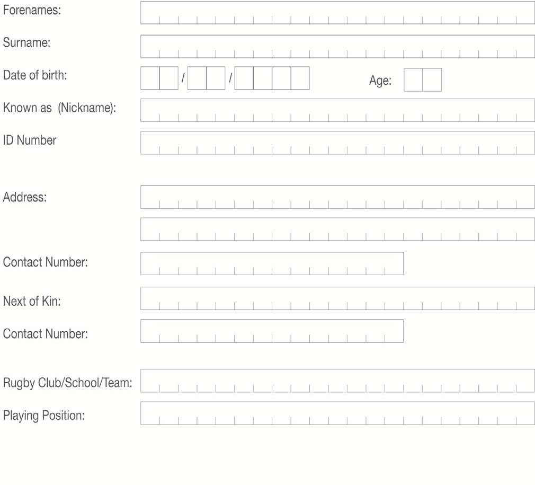
1. PLAYER (PRINT CLEARLY)
2 | Page

Slide 35
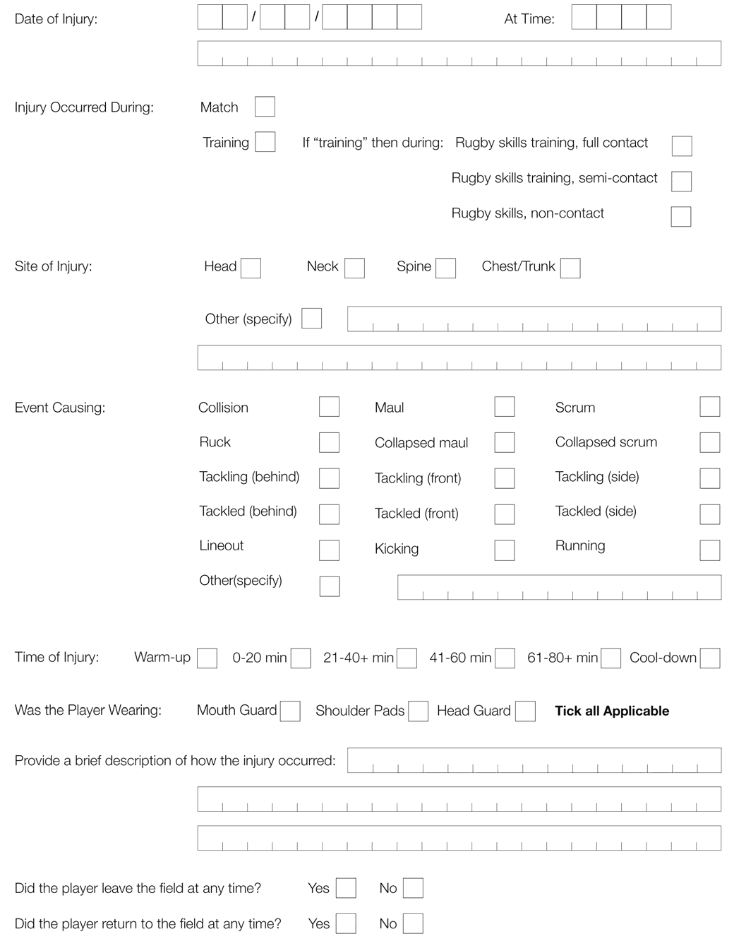
2. INJURY (PRINT CLEARLY)
3 | Page

Slide 36
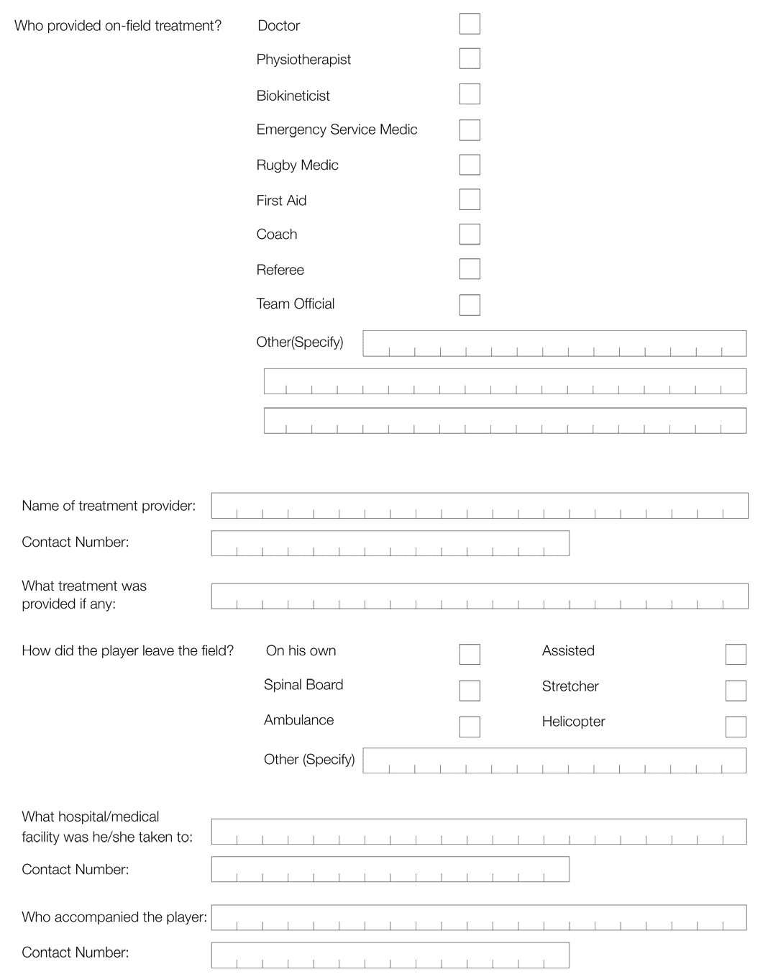
2. INJURY (PRINT CLEARLY) - CONTINUED
4 | Page

Slide 37
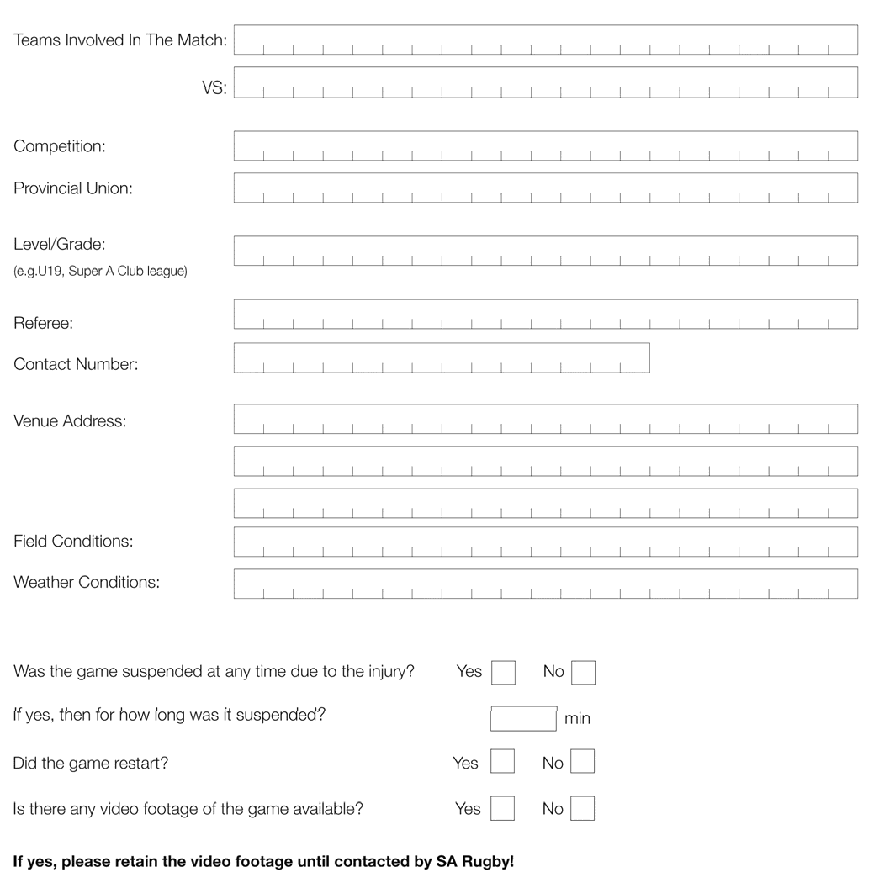
3. MATCH (PRINT CLEARLY)
5 | Page

Slide 38
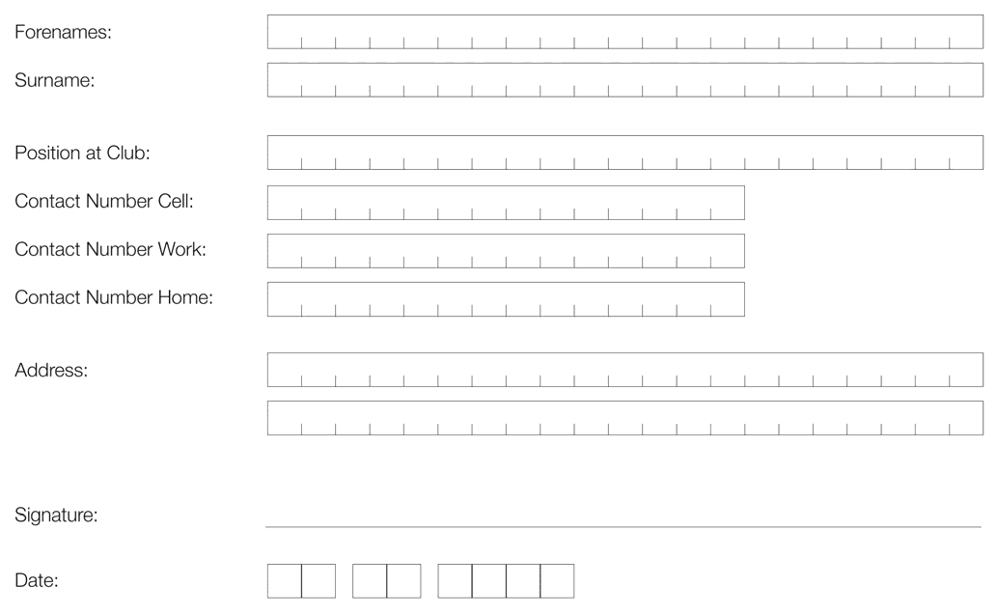
4. CLUB CONTACT (PRINT CLEARLY)
5. PROVINCIAL UNION BOKSMART COORDINATOR CONTACT DETAILS:
Union BokSmart Representatives
UNION | REPRESENTATIVE | MOBILE | OFFICE | FAX | EMAIL
Boland | Cliffie Booysen | 0829950117 | 021 8732317 | 021 8734823 | cliffie@bolandrugby.co.za
Border | Sindile Mayende | 0842614864 | 043 7435998 | 043 7436613 | sindile@borderrugby.co.za
Blue Bulls | Kosie Horn | 0824995095 | 012 4200709 | 086 5940034 | kosie@bluebull.co.za
SWD Eagles | Martin de Vos | 0734442551 | 044 8730137 | 044 8730405 | martin@swdeagles.co.za
EP Kings | Neville Jonas | 0739602470 | 041 4088922 | 086 7432977 | neville@eprugby.co.za
Free State | Selvyn Colby | 0827722332 | 051 4071702 | 051 4071791 | scolby@fsrugby.co.za
Griquas | Kat Swanepoel | 0828223770 | 053 832 8773 | 086 620 9282 | Refs@gwrugby.co.za
Griffons | Steps (Stefan) Pretorius | 0728310998 | 057 3526482 | 086 6862018 | chellas7@yahoo.com
Leopards | Henry Stewart | 0845876369 | 018 2975304 | 018 2971657 | stewart@leopardsrugby.co.za
Lions | Timmy Goodwin | 0828508707 | 011 4022960 | 086 6862018 | timmy@glru.co.za
Pumas | Hendry Matonsi | 0823595907 | 013 6562647 | 086 5249906 | hendry@pumas.co.za
Sharks | Archie Sehlako | 0823847787 | 031 3088426 | 031 3129197 | archie@thesharks.co.za
Valke | Alfred Ross | 0824573278 | 016 9762112 | 016 9762034 | aross@icon.co.za
WP | Ben Theron | 0832693590 | 021 6594502 | 021 9592336 | BTheron@wprugby.co.za
6 | Page

Slide 39






Serious Injury Report Follow‐Up Questionnaire
www.BokSmart.com
/BokSmart
@BokSmart
Serious Injury Report Follow‐up Questionnaire
A serious and/or catastrophic injury is defined as any head, neck,
spine, or brain injury that is life‐threatening, or has the potential to be permanently debilitating and results in the emergency admission of a rugby player to a hospital or medical care centre.

Slide 40
Serious Injury Report Follow‐Up Questionnaire
WHAT TO DO!
In the event of a serious and/or catastrophic injury meeting the above mentioned criteria, the following form should be completed by the injured player and/or coach in conjunction with the Serious Injury Case Manager, Mrs. Gail Baerecke – Cell: 0728903538, e‐mail: manager@playersfund.org.za, fax: 021 659 5653
If for some reason this is not possible, then the questionnaire should be completed by the Serious Injury Case Manager in consultation with the coach, other players, and family who might have seen the incident
Although it might be sensitive and emotional to recall the incident, it would benefit rugby and future rugby players if the follow‐up questionnaire is completed while the incident is still fresh in everyone’s minds
This form should then be kept on record pending any inquest or investigation
Copies should be sent to the SARU’s Senior Manager: Medical and SARU’s Senior Manager: Rugby Safety
RESEARCH
All serious injury data collected will be recorded and stored on a SARU database. Personal details will be provided to the Chris Burger/Petro Jackson Players Fund, who may provide financial assistance and support to catastrophically injured rugby players. This information will be stored at SARU’s offices for official records of these injuries. The injury data may be used for research and publication purposes to help improve the safety standards of the game of rugby in South Africa, and to potentially prevent other injuries of this nature from occurring in the future. However, in this instance, all personal information will be regarded as confidential in any ensuing research analyses and reports on the catastrophically injured players.
 By ticking this box, the player agrees to the above
WORLD RUGBY (WR) (FORMERLY KNOWN AS ‘INTERNATIONAL RUGBY BOARD’ OR ‘IRB’)
All data collected will be forwarded anonymously to WORLD RUGBY and stored in a secure WORLD RUGBY database of catastrophic injuries. These data may be analysed by WORLD RUGBY for audit, player welfare, research purposes in relation to the prevention, and management of Rugby‐related catastrophic injuries.
 By ticking this box, the player agrees to the above
PLAYER’S CONSENT
It is hereby confirmed that the player or player’s family, whichever may be applicable, has given permission to use and submit the information requested by this form and that they agreed that the information can be forwarded to WORLD RUGBY, and be used by both SARU and WORLD RUGBY for the purposes of monitoring and investigating the causes of catastrophic injuries sustained in Rugby Union.
 By ticking this box, the player agrees to the above

Slide 41
Serious Injury Report Follow‐Up Questionnaire
SECTION A: PERSONAL DETAILS (PRINT CLEARLY)
Surname: Age of Player: Forenames: Known as (nickname): Date that form was completed:
D D / M M / Y Y Y Y
Email address:
ID Number:
Passport Number:
Passport type (country of issue):
Marital status:
Playing position:
SARU Registration number:
Residential address:
Tel./Cell. Number:
Next of Kin:
Contact number (next of kin):
Name of Rugby Club/School:
Provincial Union (e.g. Bulls):

Slide 42
Serious Injury Report Follow‐Up Questionnaire
1. Date of Birth
D
D
/
M
M /
Y
Y
Y
Y
Gender: Male
Player’s Weight in Kilogram (kg)
Female
At the time of Injury: kg
What is the player’s current weight? kg
Player’s Height in Cm at the time of injury (cm): cm
Country of birth:
Ethnicity:
 Arabic
 Asian
 Black African
 Black Caribbean
 Pacific Islander
 White
 Coloured/Mixed Ancestry
 Indian
 Other
What age did the player start playing rugby?
Number of years that the player has been playing rugby:
How many seasons of rugby has the player played prior to this season:
Grade of play
  Player’s current grade of play (please select highest level of play)
 School
 School Provincial
 School International
 Club
 Non‐professional Provincial
 Professional Provincial
 International

Slide 43
Serious Injury Report Follow‐Up Questionnaire
b. Player’s current playing age‐group
 Junior (<U13)
 U13
 U14
 U15
 U16
 U17
 U18
 U19
 U21
 U23
 Senior
Is the player registered at their Province?
 Yes  No
Is the player registered at SARU?
 Yes  No
11. Player’s Usual playing position:
 1 – Loose‐head prop
 2 – Hooker
 3 – Tight‐head prop
 4 – Lock
 5 – Lock
 6 – Open‐side flank
 7 – Blind‐side flank
 8 – Eighth man
 9 – Scrum/Inside half
 10 – Fly/Outside half
 11 – Left Wing
 12 – Inside centre
 13 – Outside centre
 14 – Right Wing
 15 – Full back
Number of years the player has been playing in this position:
Provide any specific, relevant information about the player’s background:

Slide 44
Serious Injury Report Follow‐Up Questionnaire
SECTION B: INJURY CIRCUMSTANCES (PRINT CLEARLY)
14. How well did the player recall the events of the day?
 No recollection
 Vaguely remembered
 Somewhat
 Well
 Extremely well
15.
a. Date of Injury
D
D
/
M
M
/
Y
Y
Y
Y
b. Time that the injury occurred:
H H
16. Did the injury occur during:
:
M
M
am / pm
 Match
 15‐a‐side match
 7‐a‐side match
 Training activity
 Rugby skills training, Full contact
 Rugby skills training, Semi‐contact
 Rugby skills training, Non‐contact
 Was match/training under:
 Natural light
 Artificial light
 Other (please specify):

Slide 45
Serious Injury Report Follow‐Up Questionnaire
17.
At what stage of the season did the injury occur?
 Off‐season
 Pre‐season
 In‐season
 First month of the season
 Mid‐season
 Last month of the season
What type of match was it?
Level of the game
 School
 School Provincial
 School International
 Club
 Non‐professional Provincial
 Professional Provincial
 International
Type of game
 Tournament/Competition
 Friendly match
 League match
 Practice match
 Social match
 Hostel league match
 Farm league match
 Informal league match
c. Grade of opposition
 School
 School Provincial
 School International
 Club
 Non‐professional Provincial
 Professional Provincial
 International
d. In which period of the game did the injury occur?
 Warm‐up
 1st Quarter
 2nd Quarter
 3rd Quarter
 4th Quarter
 Cool‐down

Slide 46
Serious Injury Report Follow‐Up Questionnaire
Was the incident leading to the injury as a result of foul or dangerous play as defined in Law 10.4 “Dangerous Play and Misconduct”?
 Yes  No
If Yes, then answer 17f and if answered No, then complete 17g
Classifications of dangerous play
 Punching or striking
 Stamping or trampling
 Kicking
 Tripping
 Early or late tackle
 Tackle above the line of the shoulders
 Stiff‐arm tackle
 Playing a player without the ball
 Tackling an opponent whose feet are off the ground
 Dangerous charging
 Scrum front row rushing opponents
 Scrum front row lifting opponents
 Collapsing a scrum, ruck or maul
 Tip/lifting/spear tackle
 Retaliation
g. Did the referee take any action?
 Yes  No
Explain:
h. Playing position at the time of injury
 1 – Loose‐head prop
 2 – Hooker
 3 – Tight‐head prop
 4 – Lock
 5 – Lock
 6 – Open‐side flank
 7 – Blind‐side flank
 8 – Eighth man
 9 – Scrum/Inside half
 10 – Fly/Outside half
 11‐ Left Wing
 12 – Inside centre
 13 – Outside centre
 14 – Right Wing
 15 – Full back

Slide 47
Serious Injury Report Follow‐Up Questionnaire
i. Was the player playing in his/her usual playing position?
 Yes  No
If the player answered No, and was not playing in his/her usual position, then give the reason why?
18. Who was officiating or leading the match / training session?
 Referee
 Coach
 No‐one
 Player
 Spectator
 Teacher
 Other (Please specify)
Was a Union‐appointed referee in control of the game?
 Yes  No
20.
  Had the referee attended a SARU or WORLD RUGBY Level referee‐training course?
 Yes  No
  If Yes then give details of referee’s training:
c. Date of the most recent course attended
/ _{M M} /
Y
Y
D D Y Y
Had the referee attended a BokSmart Rugby Safety course?
 Yes  No
If Yes then provide the referee’s BS‐number:

Slide 48
Serious Injury Report Follow‐Up Questionnaire
Had the coach attended a SARU or WORLD RUGBY Level coaching course?
 Yes  No
If Yes then give details of the coach’s training:
h. Date of the most recent course attended
/ _{M M} /
D D Y Y
Y
Y
Had the coach attended a BokSmart Rugby Safety course?
 Yes  No
If Yes then provide the coach’s BS‐number:
21. Briefly describe the events that led up to the injury (if possible in the player’s own words):
SECTION C: INJURY EVENT (PRINT CLEARLY)
22.
Did the player warm‐up properly before the match or training session?
 Yes  No
Did the player stretch before the match or training session?
 Yes  No

Slide 49
Serious Injury Report Follow‐Up Questionnaire
23. Indicate the event causing the catastrophic injury (thereafter, please describe and answer the relevant and corresponding event section):
Collision
Tackle
Scrum
Ruck
Maul
Lineout
Kicking
Running
Other:
Unclear
Not applicable
 Tackle
  What was the injured player’s role in the tackle?
 Ball carrier
 Tackled from behind
 Tackled from the side
 Tackled from the front
 Support player to ball carrier
 Tackler
 Tackling from behind
 Tackling from the side
 Tackling from the front
 Support player to tackler
  What type of contact was involved?
 Arm
 Collision (no‐arms, deliberate)
 Jersey
 Lift (example spear)
 Shoulder
 Smother
 Tap

Slide 50
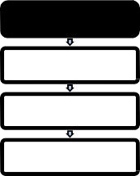
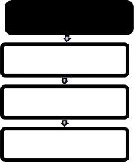
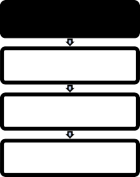
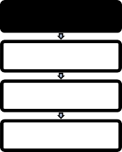
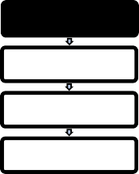
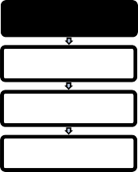
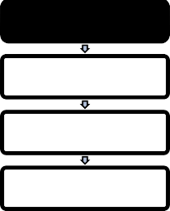
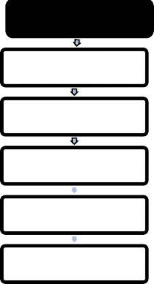
Serious Injury Report Follow‐Up Questionnaire
c. Indicate the following specifics as best you can with regards to the tackle situation;
ROLE | TACKLE HEIGHT | TACKLE DIRECTION | TACKLER'S VELOCITY | BALL CARRIER'S STANCE | BALL CARRIER'S VELOCITY
Ball carrier | High | Front‐on | Fast | Upright | Fast
Tackler | Middle | Side‐on | Slow | Low position | Slow
Support player | Low | From behind | Standing still | Falling/diving | Standing still
d. Tick off all the additional specifics as best you can with regards to the tackle situation;
Number of Tacklers
Tackle Type
1
Arms wrapped around the player
2
Shoulder charge (no arms used in the tackle)
3 or more
Spear tackle/pile drive (head below shoulders)
Head is first point of contact with the ground
Pulled /scragged by the collar
e. Please provide any further information relevant to the tackle e.g. head was first point of contact with the ground, upper body was first contact with the post, etc.
25.
 Scrum
a. Was the scrum part of a training session or match
 Training session
 Match

Slide 51

Serious Injury Report Follow‐Up Questionnaire
b. If during Training, then was this against a scrum machine or live opposition?
 Scrum machine
 How many players were going in against the machine?
 Live opposition
Indicate below how many players were contesting the scrum for both packs?
Injured player’s team
 3
 5
 6
 7
 8
Opposition team
 3
 5
 6
 7
 8
Which team had the put‐in in the scrum?
 Player’s own team
 Opposition team
Did the injury involve any of the following:
 Collapsed scrum
 Impact on engagement
 Player popping out of the scrum
 Scrum wheeling/rotating
Scrummaging injuries
Collapsed scrum
At impact
Popping out of the scrum
Screwing (rotation in the scrum)

Slide 52
Serious Injury Report Follow‐Up Questionnaire
e. Please provide any further information relevant to the scrum e.g. which player popped first, which team collapsed first, number of scrum resets, make and age of scrum machine etc.
26.
 Ruck or  Maul
a. What was the injured player’s role in the ruck/maul?
 Ball carrier
 Support player to ball carrier
 Tackler
 Support player to tackler
Body position at the time of injury
 On feet
 Off feet
 Bridging
 Supported
During the ruck/maul did the injury occur during any of the following?
 Cleaning out
 Cleaned out
 Collapsed maul
 Squeeze ball (ball pinned between legs)
 Other (please specify)
d. Please provide any further information relevant to the ruck/maul

Slide 53
Serious Injury Report Follow‐Up Questionnaire
27.
 Lineout
Identify how the injury occurred:
 ‘Lifted player’ fell during landing (no other player involved)
 ‘Lifted player’ fell during landing (other player(s) involved)
 ‘Lifting player’ injured (no other player involved)
 ‘Lifting player’ injured (other player(s) involved)
 Other (please specify below)
Please provide any further information relevant to the lineout e.g. which body part first made contact with the ground, etc.
Other categories
 Non‐contact training
 Collision (if accidental, then describe below)
 Kicking
 Running
  Please provide relevant information to the activity being undertaken at the time of injury e.g. weight training, passing drills, running drills, phase play simulations etc.

Slide 54
Serious Injury Report Follow‐Up Questionnaire
SECTION D: IMMEDIATE POST‐INJURY CARE (PRINT CLEARLY)
29.
Who of the following medical or allied health professionals were the first to provide on‐field treatment or support to the injured player during the match or training session?
 Medical Doctor
 Physiotherapist
 Biokineticist
 Emergency Service Medic (paramedic)
 First Aider
 Nurse
 None
When was the injured player FIRST attended to by the medical or allied health professional?
 On the pitch
 Off the pitch
Was the player FIRST attended to by someone OTHER than a medical or allied health professional?
 Yes  No
  If answered Yes, then by whom?
 BokSmart Rugby Medic
 Coach
 Referee
 Spectator
 Team official
 Other (Please specify)

Slide 55
Serious Injury Report Follow‐Up Questionnaire
b. What actions were taken by this person?
 Player moved on the pitch
 Player removed from the pitch
 None e.g. waited for arrival of the paramedics/doctor
 Other (Please specify)
Who managed/assisted with the removal of the player from the pitch (was in charge/helped out)?
 Medical Doctor
 Physiotherapist
 Biokineticist
 Emergency Service Medic (paramedic)
 First Aider
 Nurse
 BokSmart Rugby Medic
 Coach
 Referee
 Spectator
 Team official
 Player walked off unassisted
 Other player(s)
 Other (Please specify)
What equipment was used in the removal of the injured player from the pitch?
  Did they place a brace/collar over the neck?  Yes  No
  Was the injured player placed on a stretcher?  Yes  No
  Was the injured player placed on a spinal board?  Yes  No
  Was the injured player stabilised using a spider harness?  Yes  No
  Were head‐blocks used to immobilise/stabilise the injured player’s head and neck?  Yes  No
  Was Oxygen used?  Yes  No
  Other (Please specify)
Did the player leave the field at any time during the match before the injury and
return to the field of play?
 Yes  No

Slide 56
Serious Injury Report Follow‐Up Questionnaire
34. Was the BokSmart Spineline number (0800 678 678) contacted at any given stage during the management of the injured player?
 Yes  No
If answered No, then why not?
Was the player taken immediately to hospital?
 Yes  No
  How long did the player have to wait before being taken to hospital?
 < 1 hour
 1‐2 hours
 2‐3 hours
 3‐4 hours
 > 4 hours
b. If more than 4 hours passed before being taken to hospital, then please specify the reasons why?
How was the injured player taken to hospital?
 Ambulance
 Car
 Helicopter
 Other (Please specify)
What hospital/medical facilities was the player taken to?

Slide 57
Serious Injury Report Follow‐Up Questionnaire
Was the injured player wearing any of the following at the time?
 Mouthguard
 Shoulder pads
 Headgear
SECTION E: EXPERIENCE AND TRAINING (PRINT CLEARLY)
The number of games played by the injured player this season prior to injury?
Within the last 12 months did the injured player receive training from a qualified coach/trainer on how to safely and correctly perform the following activities?
  Tackling techniques Yes No
  Ball carrying techniques Yes No
  Safe techniques in contact Yes No
  Scrum techniques Yes No Not relevant
  Scrum engagement Yes No Not relevant
  Falling correctly in a collapsed scrum Yes No Not relevant
  Ruck techniques Yes No
  Entering the ruck Yes No
  Maul techniques Yes No
  Entering a maul Yes No
  Lineout techniques Yes No Not relevant
  Supporting in a lineout Yes No Not relevant
  Supporting a jumper at kick‐off Yes No Not relevant
Did the player have a regular coach other than the head coach of the team in charge of his/her rugby development?
 Yes  No
If Yes, then answer 41 (a‐ e)
  Had the coach attended a SARU or WORLD RUGBY Level coaching course?
 Yes  No

Slide 58
Serious Injury Report Follow‐Up Questionnaire
b. If Yes then give details of the coach’s training:
c. Date of the most recent course attended
/ _{M M} /
Y
Y
D D Y Y
Had the coach attended a BokSmart Rugby Safety course?
 Yes  No
If Yes then provide the coach’s BS‐number:
42.
Did the player receive specific coaching for his/her position by a qualified coach?
 Yes  No
Did the player receive specific conditioning for his/her position by a qualified trainer?
 Yes  No
How long before the season did the player take part in pre‐season strength and fitness conditioning?
 Never
 1‐2 weeks
 3‐4 weeks
 1‐2 months
 2‐3 months
 ≥ 3 months
How many training sessions did the player undertake each week during the pre‐ season training period? (Please give number of sessions or 0 if none was undertaken)
  Individual training sessions per week
  Team training sessions per week

Slide 59
Serious Injury Report Follow‐Up Questionnaire
45. On average, how many formal structured rugby training sessions did the player perform per week (at the time of injury)?
 Never
 1
 2
 3
 More than 3
46. Other than the official team training sessions, what individual training did the player perform? Specify how often, the type of activity, average duration of each session, etc.
Activity
Intensity How many times per week Average duration (min)
Easy Moderate Tough Very hard
 | E | M | T | VH |  | min
 | E | M | T | VH |  | min
 | E | M | T | VH |  | min
 | E | M | T | VH |  | min
 | E | M | T | VH |  | min
47. Did the player participate in any strength/resistance/weight training at least twice per week during the season?
 Yes  No
If YES, then for how many years has the player been performing structured strength/resistance/weight training and specify to what degree?
48. Did the player participate in any neck strengthening exercises?
 Yes  No If YES, specify:
 Rarely, no more than 1 session per season
 Occasionally, less than 1 session per month
 Often, at least 1 session per month
 Regularly, at least 1 session per week

Slide 60
Serious Injury Report Follow‐Up Questionnaire
For more detail on neck strengthening, please complete the table below:
Activity
Intensity How many times per week Average duration (min)
Easy Moderate Tough Very hard
 | E | M | T | VH |  | min
 | E | M | T | VH |  | min
 | E | M | T | VH |  | min
 | E | M | T | VH |  | min
 | E | M | T | VH |  | min
Compared to the injured player’s normal training regime, in the week preceding the injury, what was the training level?
  Training Volume
 Lower
 The same
 Higher
  Training Intensity
 Lower
 The same
 Higher
If injured in the scrum, then please answer the following:
  How many scrum engagements did the injured player typically practice per session?
  Compared to the injured player’s normal training regime, in the week preceding the injury, what was the SCRUM SPECIFIC training level:
    Training Volume
 Lower
 The same
 Higher

Slide 61
Serious Injury Report Follow‐Up Questionnaire
ii. Training Intensity
 Lower
 The same
 Higher
Did the player follow any special diet/eating plan before or during the season?
 Yes  No
Did the player use any specific supplements before or during the season?
 Yes  No
  If YES, elaborate
SECTION F: PLAYING CONDITIONS (PRINT CLEARLY)
53. What was the weather like on the day of injury? Please tick all of the appropriate answers:
 Hot
 Dry
 Light Rain
 Overcast
 Cold
 Heavy Rain
 Windy
 Other (Please specify):
Were the weather conditions on the day of the player’s injury typical for the location and time of year?
 Yes  No
If NO, what are the typical weather conditions for the location and time of year at which the injury occurred?

Slide 62
Serious Injury Report Follow‐Up Questionnaire
c. What was the temperature at the time of injury? (You can get this information from the local weather service)
54. On what type of surface did the injury occur?
 Wood e.g. gym floor
 Tarmac or similar
 Concrete
 Natural grass
 Artificial turf – rubber infill
 Artificial turf – sand infill
 Dirt or sand
 Gravel
 Other (Please specify):
How hard was the field or surface?
 Soft
 Firm
 Very hard
How was the surface of the field?
 Slippery
 Medium grip
 Good, solid footing (hard grip)
What was the condition of the playing surface?
   Even
 Flat and rough
 Flat and smooth
   Uneven
 Sloping and rough
 Sloping and smooth
Does the player feel that the field condition contributed towards the injury?
 Yes  No

Slide 63
Serious Injury Report Follow‐Up Questionnaire
59. If answered YES, please specify
What type of footwear was the player using at the time of injury?
 None
 Trainers/tekkies
 Studded boots
 Other (Please specify):
If wearing studded boots, please tick all applicable answers below:
 Brand new
 Worn in
 Old/damaged
 Short studs
 Long studs
 Multi studs
 Six studs
 Other (Please specify):
In the player’s opinion, what was the main cause of his/her injury?
63. Does the player have any recommendations to prevent others from sustaining a similar injury?

Slide 64






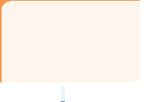





Serious Injury Report Follow‐Up Questionnaire
SECTION G: OUTCOME OF INJURY (PRINT CLEARLY)
Outcome of Injury Classification Matrix for Cervical Spinal Cord Injuries (C1‐C7):
Outcome of "C‐Spine" injury
Asia Scale A, B & C
Asia Scale D
Asia Scale E
Deceased
Acute Spinal Cord Injury ‐ Quadriplegics
Acute Spinal Cord Injury ‐ Neurological deficit
Acute Spinal Cord injury ‐ "Near misses"
Quadriplegia and wheelchair‐bound
Residual Damage but walks WITH assistive devices and may be in a wheelchair
Residual Damage but walks WITHOUT assistive devices
No apparent damage and full recovery expected
64. What was the initial hospital‐based diagnosis?
 Deceased
 A fatal spinal cord injury
 A fatal head injury
 Cardiac event
 Other e.g. stroke:
 Non‐fatal Spinal Cord Injury
 Quadriplegia and Wheelchair bound
 Potential catastrophic injury with recovery (residual damage but walks with assistive devices and may be in a wheelchair)
 Potential catastrophic injury with recovery (residual damage but walks without assistive devices)
 No apparent residual damage and full recovery expected

Slide 65













Serious Injury Report Follow‐Up Questionnaire
 Head injuries (see Question 66)
 Fully recovered
 With disability
65. Asia Impairment Scale for Cervical Spinal Cord injured players at time of diagnosis
 A – Complete: no motor or sensory function is preserved in the sacral segments S4‐S5
 B – Incomplete: sensory but not motor function is preserved below the neurological level, and includes the sacral segments S4‐S5
 C – Incomplete: motor function is preserved below the neurological level,
and more than half of key muscles below the neurological level have a muscle grade less than 3
 D – Incomplete: motor function is preserved below the neurological level and at least half of key muscles below the neurological level have a muscle grade of 3 or more
 E – Normal: motor and sensory function are normal
Outcome of Injury Classification Matrix for Head or TBI Injuries
Outcome of TBI
Fully Recovered
With Functional Disability
Glasgow Coma Scale
Glasgow Outcome Scale
Severe (GCS ≤8)
Moderate (GCS 9‐12)
Mild (GCS ≥13)
Death
Persistent Vegetative state
Severe Disability
Moderate Disability
Good Recovery

Slide 66
Serious Injury Report Follow‐Up Questionnaire
Glasgow Coma Scale (GCS) for Head or Brain (TBI) injured players at time of
diagnosis:
 Mild (GCS ≥ 13) – loss of consciousness and/or confusion and disorientation was shorter than 30 minutes
 Moderate (GCS 9‐12) – loss of consciousness >30 minutes; physical or
cognitive impairments that may or may not resolve; benefit from rehabilitation
 Severe (GCS ≤ 8) – Coma; unconscious state; no meaningful response; no voluntary activities
Glasgow Outcome Scale (GOS) for Head or Brain (TBI) injured players at discharge:
 Death
 Persistent Vegetative state – A vegetative state that lasts for longer than 1 month. A vegetative state consists of sleep‐wake cycles, arousal but no interaction with the environment and no localised response to pain
 Severe Disability (conscious but disabled) – patient depends on others for daily support due to mental or physical disability or both
 Moderate disability (disabled but independent) – patient is independent as far as daily life is concerned. The disability found includes varying degrees of dysphasia, hemiparesis, ataxia, as well as intellectual and memory deficits and personality changes
 Good recovery – Resumption of normal activities even though there may be minor neurological or psychological deficits
SECTION H: PLAYER’S MEDICAL HISTORY (PRINT CLEARLY)
  Did the player suffer from any medical conditions or illnesses that interrupted their training or match play in the week prior to the injury?
 Yes  No
  If YES, then describe the conditions/illnesses:

Slide 67
Serious Injury Report Follow‐Up Questionnaire
69.
Does the player have any long‐term medical conditions or illnesses that may be relevant to the injury e.g. epilepsy, diabetes?
 Yes  No
If YES, then describe the conditions/illnesses:
70.
Does the player have a history of “stinger” (also known as burner, nerve pinch and brachial plexus injuries)?
 Yes  No
If YES, then describe the history:
71.
Had the player ever sustained a previous neck/spinal injury before?
 Yes  No
If YES, then please provide details of the nature and circumstances of the previous neck/spinal injury:

Slide 68
Serious Injury Report Follow‐Up Questionnaire
Had the player ever sustained a previous SIGNIFICANT neck/spinal injury (that is requiring hospital admission or scans (MRI or CT scan), with prolonged symptoms for over 1 month, associated with arm symptoms or preventing play for more than 2 weeks):
 Yes  No
If YES, then please provide details of the nature and circumstances of the previous SIGNIFICANT neck/spinal injury:
Had the player fully recovered from the previous SIGNIFICANT neck/spinal injury before starting the match/training session in which the current injury was sustained?
 Yes  No
Did the player receive treatment for the previous neck/spinal injury?
 Yes  No
Briefly describe the treatment received:
72.
Had the player ever sustained a previous head/brain/concussion injury before?
 Yes  No
If YES, then please provide details of the nature and circumstances of the previous head/brain/concussion injury:

Slide 69
Serious Injury Report Follow‐Up Questionnaire
Had the player ever sustained a previous SIGNIFICANT head/brain/concussion injury (with symptoms lasting more than 3 weeks or requiring hospital admission or scans (MRI or CT scan)):
 Yes  No
If YES, then please provide details of the nature and circumstances of the previous SIGNIFICANT head/brain/concussion injury:
Had the player fully recovered from the previous SIGNIFICANT head/brain/concussion injury before starting the match/training session in which the current injury was sustained?
 Yes  No
Did the player receive treatment for the previous SIGNIFICANT head/brain/concussion injury?
 Yes  No
Briefly describe the treatment received:

